Slide 1
W4111 – Introduction to Databases Module II (3), NoSQL (3)
© Donald F. Ferguson, 2025

Slide 2

Contents
2 | W4111-2025S-10-Module-II-NoSql-3 © Donald F. Ferguson, 2025

Slide 3
Contents
Course update
Homework schedule
Final exam information
Module II – DBMS architecture and implementation
DBMS architecture and implementation reminder
Query processing
Overview
Query cost
Algorithms for SELECT
Algorithms for JOIN
Other operations
Evaluation
Module III – NoSQL
Reminder
Graph databases
Neo4j
Web applications (full stack) and REST

Slide 4
Course Update
4 | W4111-2025S-10-Module-II-NoSql-3 © Donald F. Ferguson, 2025

Slide 5
Course Update
Tentative/current HW schedule
HW4: Released 05-April and due 19-April.
HW5: Release 19-April and due 03-May.
Final exam
Is cumulative.
It will be on-line, and the process is like the midterm.
We will release the exam on 02-May. You will have until 16-May to take it.
Final lecture
I will record the final lecture for 02-May but am not available at the time.
So, you are responsible for the content, but you do not need to attend the time slot.

Slide 6
Module II – DBMS Architecture and Implementation
6 | W4111-2025S-10-Module-II-NoSql-3 © Donald F. Ferguson, 2025

Slide 7

Module II – DBMS Architecture and Implementation
Overview and Reminder
7 | W4111-2025S-10-Module-II-NoSql-3 © Donald F. Ferguson, 2025

Slide 8
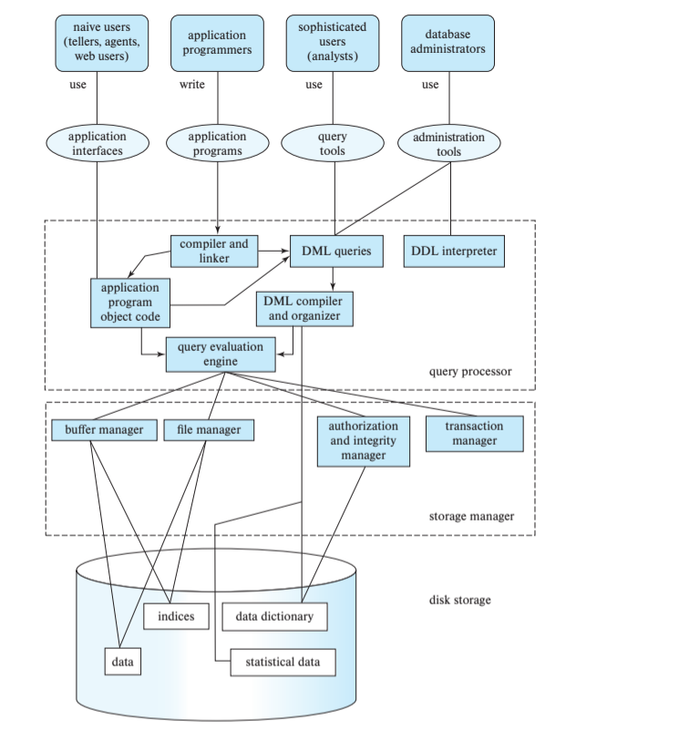
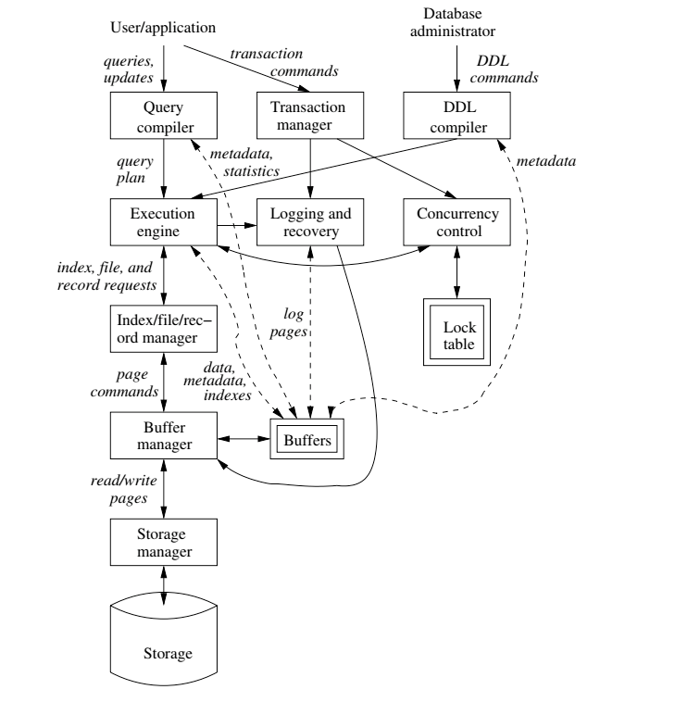
DBMS Arch.

Slide 9

Data Management
Last Week
Query Processing
Query Optimization
Query Execution
Previously
Storage
Storage Manager
Buffer Manager
Index Manager
Database Systems: The Complete Book (2nd Edition) by Hector Garcia-Molina (Author), Jeffrey D. Ullman (Author), Jennifer Widom (Author)

Slide 10
Query Processing Overview
10 | W4111-02024F-9-Module-II(3)-NoSql(3) © Donald F. Ferguson, 2024

Slide 11
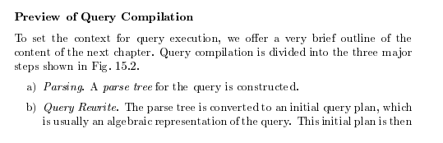
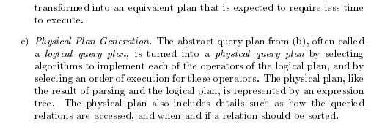
Query Compilation
Database Systems: The Complete Book (2nd Edition) 2nd Edition
by Hector Garcia-Molina (Author), Jeffrey D. Ullman (Author), Jennifer Widom (Author)

Slide 12
Basic Steps in Query Processing
1. Parsing and translation
2. Optimization
3. Evaluation

Slide 13
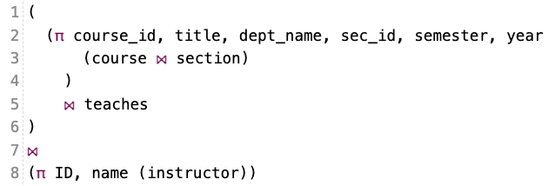
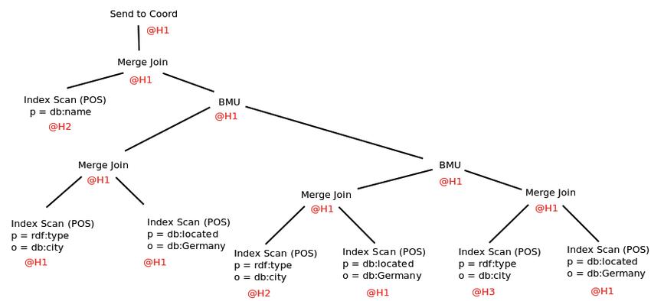
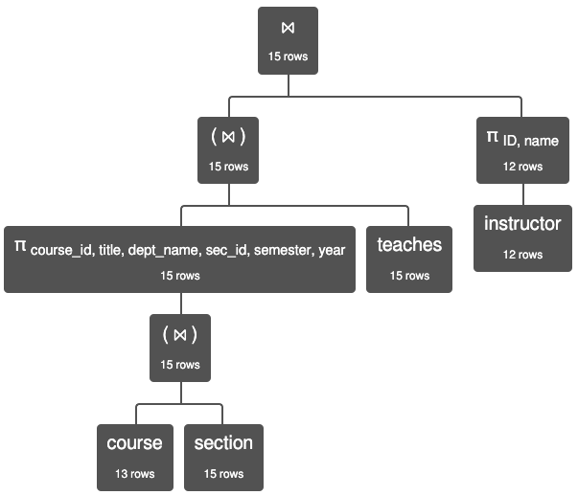
Query Processing

Slide 15
Parsing and Execution
Parser/Translator
Verifies syntax correctness and generates a parse tree.
Converts to logical plan tree that defines how to execute the query.
Tree nodes are operator(tables, parameters)
Edges are the flow of data “up the tree” from node to node.
Optimizer
Modifies the logical plan to define an improved execution.
Query rewrite/transformation.
Determines how to choose among multiple implementations of operators.
Engine
Executes the plan
May modify the plan to optimize execution, e.g. using indexes.

Slide 16
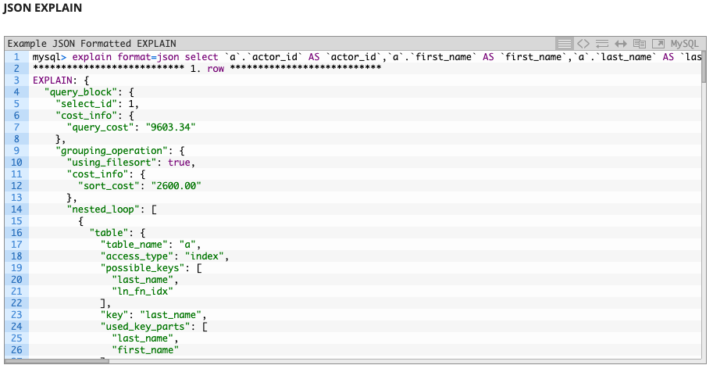
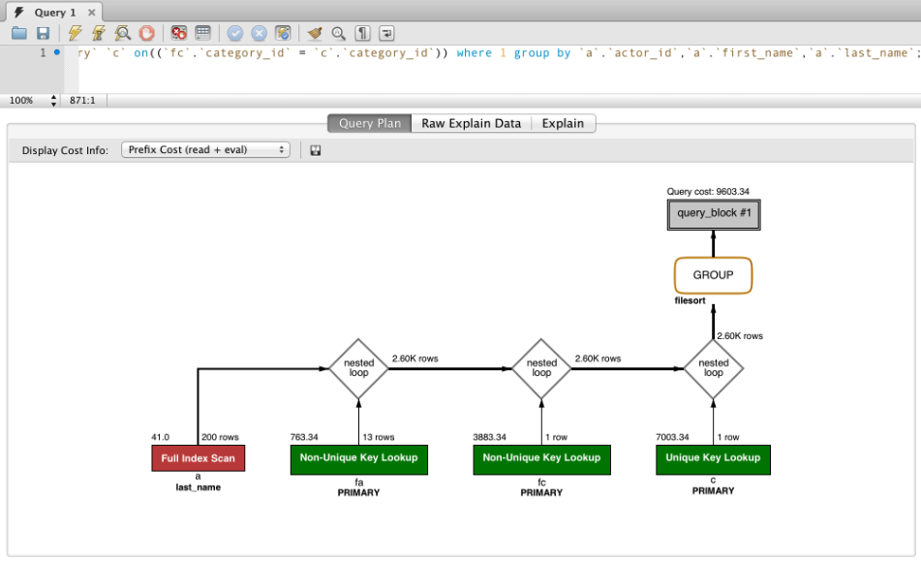
EXPLAIN Example

Slide 17
Basic Steps in Query Processing: Optimization
A relational algebra expression may have many equivalent expressions
E.g., σ_{salary<75000}(∏_{salary}(instructor)) is equivalent to ∏_{salary}(σ_{salary<75000}(instructor))
Each relational algebra operation can be evaluated using one of several different algorithms
Correspondingly, a relational-algebra expression can be evaluated in many ways.
Annotated expression specifying detailed evaluation strategy is called an evaluation-plan. E.g.,:
Use an index on salary to find instructors with salary < 75000,
Or perform complete relation scan and discard instructors with salary ≥ 75000

Slide 18
Basic Steps: Optimization (Cont.)
Query Optimization: Amongst all equivalent evaluation plans choose the one with lowest cost.
Cost is estimated using statistical information from the database catalog
e.g.. number of tuples in each relation, size of tuples, etc.
In this chapter we study
How to measure query costs
Algorithms for evaluating relational algebra operations
How to combine algorithms for individual operations in order to evaluate a complete expression
In Chapter 16
We study how to optimize queries, that is, how to find an evaluation plan with lowest estimated cost

Slide 19
Query Cost
19 | W4111-02024F-9-Module-II(3)-NoSql(3) © Donald F. Ferguson, 2024

Slide 20
Measures of Query Cost
Many factors contribute to time cost
disk access, CPU, and network communication
Cost can be measured based on
response time, i.e. total elapsed time for answering query, or
total resource consumption
We use total resource consumption as cost metric
Response time harder to estimate, and minimizing resource consumption is a good idea in a shared database
We ignore CPU costs for simplicity
Real systems do take CPU cost into account
Network costs must be considered for parallel systems
We describe how estimate the cost of each operation
We do not include cost to writing output to disk

Slide 21
Measures of Query Cost
Disk cost can be estimated as:
Number of seeks * average-seek-cost
Number of blocks read * average-block-read-cost
Number of blocks written * average-block-write-cost
For simplicity we just use the number of block transfers from disk and the number of seeks as the cost measures
t_{T} – time to transfer one block
Assuming for simplicity that write cost is same as read cost
t_{S} – time for one seek
Cost for b block transfers plus S seeks b * t_{T} + S * t_{S}
t_{S} and t_{T} depend on where data is stored; with 4 KB blocks:
High end magnetic disk: t_{S} = 4 msec and t_{T} =0.1 msec
SSD: t_{S} = 20-90 microsec and t_{T} = 2-10 microsec for 4KB
If I ask a query cost estimation question on a HW or exam, you only need to estimate the number of block transfers.

Slide 22
Measures of Query Cost (Cont.)
Required data may be buffer resident already, avoiding disk I/O
But hard to take into account for cost estimation
Several algorithms can reduce disk IO by using extra buffer space
Amount of real memory available to buffer depends on other concurrent queries and OS processes, known only during execution
Worst case estimates assume that no data is initially in buffer and only the minimum amount of memory needed for the operation is available
But more optimistic estimates are used in practice
Notes:
22

Slide 23
Algorithm Selection
23 | W4111-02024F-9-Module-II(3)-NoSql(3) © Donald F. Ferguson, 2024

Slide 24
Selection Operation
File scan
Algorithm A1 (linear search). Scan each file block and test all records to see whether they satisfy the selection condition.
Cost estimate = b_{r} block transfers + 1 seek
b_{r} denotes number of blocks containing records from relation r
If selection is on a key attribute, can stop on finding record
cost = (b_{r} /2) block transfers + 1 seek
Linear search can be applied regardless of
selection condition or
ordering of records in the file, or
availability of indices
Note: binary search generally does not make sense since data is not stored consecutively
except when there is an index available,
and binary search requires more seeks than index search
This seems to assume that all blocks for the relation are on the same cylinder.

Slide 25
Selections Using Indices
Index scan – search algorithms that use an index
selection condition must be on search-key of index.
A2 (clustering index, equality on key). Retrieve a single record that satisfies the corresponding equality condition
Cost = (h_{i} + 1) * (t_{T} + t_{S})
A3 (clustering index, equality on nonkey) Retrieve multiple records.
Records will be on consecutive blocks
Let b = number of blocks containing matching records
Cost = h_{i} * (t_{T} + t_{S}) + t_{S} + t_{T} * b

Slide 26

Selections Using Indices
Index scan – search algorithms that use an index
selection condition must be on search-key of index.
A2 (clustering index, equality on key). Retrieve a single record that satisfies the corresponding equality condition
Cost = (h_{i} + 1) * (t_{T} + t_{S})
A3 (clustering index, equality on nonkey) Retrieve multiple records.
Records will be on consecutive blocks
Let b = number of blocks containing matching records
Cost = h_{i} * (t_{T} + t_{S}) + t_{S} + t_{T} * b
Replace (t_{T} + t_{S}) with t_{B}, the time/cost for reading a block.
In my way of thinking, h_{i} is the “height” of the index tree.
The cost to find the index block is h_{i}* t_{B.} We then read the referenced data block, which happens once because it is a key.
If it is a non-key, we may retrieve multiple records ➔ reading multiple blocks.
But, clustering index on the non-key field ➔ the data records are sorted by the non-key ➔ records are probably on consecutive sectors on the same track ➔ one seek and then some number of block reads.

Slide 27
Selections Using Indices
A4 (secondary index, equality on key/non-key).
Retrieve a single record if the search-key is a candidate key
Cost = (h_{i} + 1) * (t_{T} + t_{S})
Retrieve multiple records if search-key is not a candidate key
each of n matching records may be on a different block
Cost = (h_{i} + n) * (t_{T} + t_{S})
Can be very expensive!
h_{i}* t_{B} to get the leaf node in the index.
Each entry in the leaf node may reference a different block in the data file.
If there are n matching records, we get
(h_{i} + n) * t_{B}
Notes:
27

Slide 28
Selections Involving Comparisons
Can implement selections of the form σ_{A≤V} (r) or σ_{A ≥ V}(r) by using
a linear file scan,
or by using indices in the following ways:
A5 (clustering index, comparison). (Relation is sorted on A)
For σ_{A ≥ V}(r) use index to find first tuple ≥ v and scan relation sequentially from there
For σ_{A≤V} (r) just scan relation sequentially till first tuple > v; do not use index
A6 (clustering index, comparison).
For σ_{A ≥ V}(r) use index to find first index entry ≥ v and scan index sequentially from there, to find pointers to records.
For σ_{A≤V} (r) just scan leaf pages of index finding pointers to records, till first entry > v
In either case, retrieve records that are pointed to
requires an I/O per record; Linear file scan may be cheaper!

Slide 29
Implementation of Complex Selections
Conjunction: σ_{θ1}∧ _{θ2}∧. . . _{θn}(r)
A7 (conjunctive selection using one index).
Select a combination of θ_{i} and algorithms A1 through A7 that results in the least cost for σ_{θi} (r).
Test other conditions on tuple after fetching it into memory buffer.
A8 (conjunctive selection using composite index).
Use appropriate composite (multiple-key) index if available.
A9 (conjunctive selection by intersection of identifiers).
Requires indices with record pointers.
Use corresponding index for each condition, and take intersection of all the obtained sets of record pointers.
Then fetch records from file
If some conditions do not have appropriate indices, apply test in memory.

Slide 30
Algorithms for Complex Selections
Disjunction:σ_{θ1}∨ _{θ2} ∨. . . _{θn} (r).
A10 (disjunctive selection by union of identifiers).
Applicable if all conditions have available indices.
Otherwise use linear scan.
Use corresponding index for each condition, and take union of all the obtained sets of record pointers.
Then fetch records from file
Negation: σ_{¬θ}(r)
Use linear scan on file
If very few records satisfy ¬θ, and an index is applicable to θ
Find satisfying records using index and fetch from file

Slide 31
Conjunctive and Disjunctive
Assume there is an index on name but not on dept_name.
Consider two simple use cases
select * from student where name=“Smith” AND dept_name=“Comp. Sci.”
select * from student where name=“Smith” OR dept_name=“Comp. Sci.”
With a conjunction, the engine must
Find and read the blocks with the correct name.
Scan each block to evaluate the rest of the AND, but this is not an I/O.
The index does not help for the disjunction because the engine still needs to scan the data file and read blocks looking for the matching OR conditions.

Slide 32
JOIN
32 | W4111-02024F-9-Module-II(3)-NoSql(3) © Donald F. Ferguson, 2024

Slide 33
Join Operation
Several different algorithms to implement joins
Nested-loop join
Block nested-loop join
Indexed nested-loop join
Merge-join
Hash-join
Choice based on cost estimate
Examples use the following information
Number of records of student: 5,000 takes: 10,000
Number of blocks of student: 100 takes: 400

Slide 34
Nested-Loop Join
To compute the theta join r ⨝ _{θ} s for each tuple t_{r} in r do begin for each tuple t_{s} in s do begin test pair (t_{r},t_{s}) to see if they satisfy the join condition θ if they do, add t_{r} • t_{s} to the result. end end
r is called the outer relation and s the inner relation of the join.
Requires no indices and can be used with any kind of join condition.
Expensive since it examines every pair of tuples in the two relations.
For clarity (or confusion), I sometimes use the terms:
Scan table for the outer relation
Probe table for the inner relation

Slide 35
Nested-Loop Join (Cont.)
In the worst case, if there is enough memory only to hold one block of each relation, the estimated cost is n_{r} ∗ b_{s} + b_{r} block transfers, plus n_{r} + b_{r} seeks
If the smaller relation fits entirely in memory, use that as the inner relation.
Reduces cost to b_{r} + b_{s} block transfers and 2 seeks
Assuming worst case memory availability cost estimate is
with student as outer relation:
5000 ∗ 400 + 100 = 2,000,100 block transfers,
5000 + 100 = 5100 seeks
with takes as the outer relation
10000 ∗ 100 + 400 = 1,000,400 block transfers and 10,400 seeks
If smaller relation (student) fits entirely in memory, the cost estimate will be 500 block transfers.
Block nested-loops algorithm (next slide) is preferable.

Slide 36

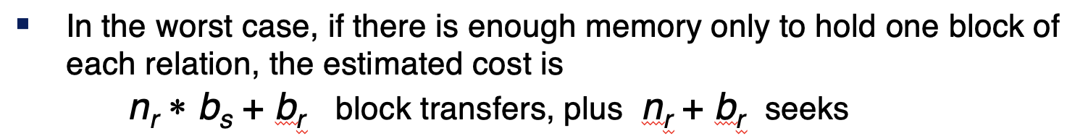
Well, That was a Clear as Mud
SELECT * from L JOIN R on L.x=R.y
The algorithm reads each block of L one time and never reads it again in JOIN.
For each record l in L, the algorithm must read each block of R one time.
The number of blocks in a relation S is, over simplistically,
#(S) is the number of records.
s(S) is the average record size.
S(b) is the block size ➔ number of blocks is #(S)/(s(b)/s(S)), which is O(#(S))
So, the number of blocks read is O(#(L))*O(#(R)) = O(#(L)*#(R))
“shmath” – Something that is completely made up but presented as precise and accurate using math symbols.

Slide 37
Indexed Nested-Loop Join
Index lookups can replace file scans if
join is an equi-join or natural join and
an index is available on the inner relation’s join attribute
Can construct an index just to compute a join.
For each tuple t_{r} in the outer relation r, use the index to look up tuples in s that satisfy the join condition with tuple t_{r}.
Worst case: buffer has space for only one page of r, and, for each tuple in r, we perform an index lookup on s.
Cost of the join: b_{r} (t_{T} + t_{S}) + n_{r} ∗ c
Where c is the cost of traversing index and fetching all matching s tuples for one tuple or r
c can be estimated as cost of a single selection on s using the join condition.
If indices are available on join attributes of both r and s, use the relation with fewer tuples as the outer relation.

Slide 38
Sorting
We may build an index on the relation, and then use the index to read the relation in sorted order. May lead to one disk block access for each tuple.
For relations that fit in memory, techniques like quicksort can be used.
For relations that don’t fit in memory, external sort-merge is a good choice.
The engine may build either a sorted index or a hash index.
The key idea is:
The cost of building the index and then using the index in the algorithm
Is cheaper than running the default algorithm with an index

Slide 39

We Really Hate this Class
One way to overly simplify these analyses is realizing that the no. of blocks is “linear” with the number of records/ tuples in a relation. ➔
Overly simplify and assume that the block size is one record.
Analyze using the number of reads as a function of no. of rows.
Assume that relation R has #(R) rows:
A tree-based lookup when you can use a key is O(log(#R)). The base of the logarithm does not materially change the analysis.
A hash-based lookup is O(1).
A scan or scan-based look up is O(#R).
Index creation cost:
Hash is O(#(R))
Tree is O(#(R)*Log(#R))
So, very roughly an index join is either
O(#(L)*Log(#(R)) + O(#(R)*Log(#(R))) = Log(#(R))*(#(L) + #(R)) or … …
O(#(L) + #(R)), but this only works for equality.
#(R)= 100
#(S) 1000000
Build index = 6 million
700 + 6 million

Slide 40
Merge-Join
1. Sort both relations on their join attribute (if not already sorted on the join
attributes).
2. Merge the sorted relations to join them
1. Join step is similar to the merge stage of the sort-merge algorithm.
2. Main difference is handling of duplicate values in join attribute —
every pair with same value on join attribute must be matched
3. Detailed algorithm in book
#(A) = n, #(B) = m
n*m
n*log(n) + m*log(m) + n + m

Slide 41
Merge-Join (Cont.)
Can be used only for equi-joins and natural joins
Each block needs to be read only once (assuming all tuples for any given value of the join attributes fit in memory
Thus the cost of merge join is: b_{r} + b_{s} block transfers + ⎡b_{r} / b_{b}⎤ + ⎡b_{s} / b_{b}⎤ seeks
+ the cost of sorting if relations are unsorted.
hybrid merge-join: If one relation is sorted, and the other has a secondary B⁺-tree index on the join attribute
Merge the sorted relation with the leaf entries of the B⁺-tree .
Sort the result on the addresses of the unsorted relation’s tuples
Scan the unsorted relation in physical address order and merge with previous result, to replace addresses by the actual tuples
Sequential scan more efficient than random lookup

Slide 42
Hash-Join
Applicable for equi-joins and natural joins.
A hash function h is used to partition tuples of both relations
h maps JoinAttrs values to {0, 1, ..., n}, where JoinAttrs denotes the common attributes of r and s used in the natural join.
r₀, r₁, . . ., r_{n} denote partitions of r tuples
Each tuple t_{r} ∈ r is put in partition r_{i} where i = h(t_{r} [JoinAttrs]).
r₀,, r₁. . ., r_{n} denotes partitions of s tuples
Each tuple t_{s} ∈s is put in partition s_{i}, where i = h(t_{s} [JoinAttrs]).
Note: In book, Figure 12.10 r_{i} is denoted as H_{ri,} s_{i} is denoted as H_{si} and n is denoted as n_{h.}
On A.x=b.y and A.z=b.q (z,q)
(x,y)

Slide 43
Hash-Join (Cont.)
On a.X=b.Z

Slide 44
Hash-Join (Cont.)
r tuples in r_{i} need only to be compared with s tuples in s_{i} Need not be compared with s tuples in any other partition, since:
an r tuple and an s tuple that satisfy the join condition will have the same value for the join attributes.
If that value is hashed to some value i, the r tuple has to be in r_{i} and the s tuple in s_{i}.

Slide 45
Hash-Join Algorithm
The hash-join of r and s is computed as follows.
1. Partition the relation s using hashing function h. When partitioning a relation, one block of memory is reserved as the output buffer for each partition.
2. Partition r similarly.
3. For each i:
(a) Load s_{i} into memory and build an in-memory hash index on it using the join attribute. This hash index uses a different hash function than the earlier one h.
(b) Read the tuples in r_{i} from the disk one by one. For each tuple t_{r} locate each matching tuple t_{s} in s_{i} using the in-memory hash index. Output the concatenation of their attributes.
Relation s is called the build input and r is called the probe input.

Slide 46
Hash-Join algorithm (Cont.)
The value n and the hash function h is chosen such that each s_{i} should fit in memory.
Typically n is chosen as ⎡b_{s}/M⎤ * f where f is a “fudge factor”, typically around 1.2
The probe relation partitions s_{i} need not fit in memory
Recursive partitioning required if number of partitions n is greater than number of pages M of memory.
instead of partitioning n ways, use M – 1 partitions for s
Further partition the M – 1 partitions using a different hash function
Use same partitioning method on r
Rarely required: e.g., with block size of 4 KB, recursive partitioning not needed for relations of < 1GB with memory size of 2MB, or relations of < 36 GB with memory of 12 MB

Slide 47
Other Operations
47 | W4111-02024F-9-Module-II(3)-NoSql(3) © Donald F. Ferguson, 2024

Slide 48
Other Operations
Duplicate elimination can be implemented via hashing or sorting.
On sorting duplicates will come adjacent to each other, and all but one set of duplicates can be deleted.
Optimization: duplicates can be deleted during run generation as well as at intermediate merge steps in external sort-merge.
Hashing is similar – duplicates will come into the same bucket.
Projection:
perform projection on each tuple
followed by duplicate elimination.
Select b,c,f from A
Union
Select a,q,r from B

Slide 49
Other Operations : Aggregation
Aggregation can be implemented in a manner similar to duplicate elimination.
Sorting or hashing can be used to bring tuples in the same group together, and then the aggregate functions can be applied on each group.
Optimization: partial aggregation
combine tuples in the same group during run generation and intermediate merges, by computing partial aggregate values
For count, min, max, sum: keep aggregate values on tuples found so far in the group.
When combining partial aggregate for count, add up the partial aggregates
For avg, keep sum and count, and divide sum by count at the end

Slide 50
Evaluation
50 | W4111-02024F-9-Module-II(3)-NoSql(3) © Donald F. Ferguson, 2024

Slide 51
Evaluation of Expressions
So far: we have seen algorithms for individual operations
Alternatives for evaluating an entire expression tree
Materialization: generate results of an expression whose inputs are relations or are already computed, materialize (store) it on disk. Repeat.
Pipelining: pass on tuples to parent operations even as an operation is being executed
We study above alternatives in more detail

Slide 52
Materialization
Materialized evaluation: evaluate one operation at a time, starting at the lowest-level. Use intermediate results materialized into temporary relations to evaluate next-level operations.
E.g., in figure below, compute and store then compute the store its join with instructor, and finally compute the projection on name.

Slide 53
Materialization (Cont.)
Materialized evaluation is always applicable
Cost of writing results to disk and reading them back can be quite high
Our cost formulas for operations ignore cost of writing results to disk, so
Overall cost = Sum of costs of individual operations + cost of writing intermediate results to disk
Double buffering: use two output buffers for each operation, when one is full write it to disk while the other is getting filled
Allows overlap of disk writes with computation and reduces execution time

Slide 54
Pipelining
Pipelined evaluation: evaluate several operations simultaneously, passing the results of one operation on to the next.
E.g., in previous expression tree, don’t store result of
instead, pass tuples directly to the join.. Similarly, don’t store result of join, pass tuples directly to projection.
Much cheaper than materialization: no need to store a temporary relation to disk.
Pipelining may not always be possible – e.g., sort, hash-join.
For pipelining to be effective, use evaluation algorithms that generate output tuples even as tuples are received for inputs to the operation.
Pipelines can be executed in two ways: demand driven and producer driven

Slide 55
Pipelining (Cont.)
In demand driven or lazy evaluation
system repeatedly requests next tuple from top level operation
Each operation requests next tuple from children operations as required, in order to output its next tuple
In between calls, operation has to maintain “state” so it knows what to return next
In producer-driven or eager pipelining
Operators produce tuples eagerly and pass them up to their parents
Buffer maintained between operators, child puts tuples in buffer, parent removes tuples from buffer
if buffer is full, child waits till there is space in the buffer, and then generates more tuples
System schedules operations that have space in output buffer and can process more input tuples
Alternative name: pull and push models of pipelining

Slide 56
Pipelining (Cont.)
Implementation of demand-driven pipelining
Each operation is implemented as an iterator implementing the following operations
open()
E.g., file scan: initialize file scan
state: pointer to beginning of file
E.g., merge join: sort relations;
state: pointers to beginning of sorted relations
next()
E.g., for file scan: Output next tuple, and advance and store file pointer
E.g., for merge join: continue with merge from earlier state till next output tuple is found. Save pointers as iterator state.
close()

Slide 57
NoSQL
57 | 57 | W4111-02024F-9-Module-II(3)-NoSql(3) © Donald F. Ferguson, 2024
© Donald F. Ferguson, 2025

Slide 58
Reminder
58 | W4111-02024F-9-Module-II(3)-NoSql(3) © Donald F. Ferguson, 2024

Slide 59
Simplistic Classification (https://medium.com/swlh/4-types-of-nosql-databases-d88ad21f7d3b)
Relational is the foundational model.
We will see OLAP in a future lecture.
Subject of this lecture and part of HW3
We covered graphs and examples.

Slide 60
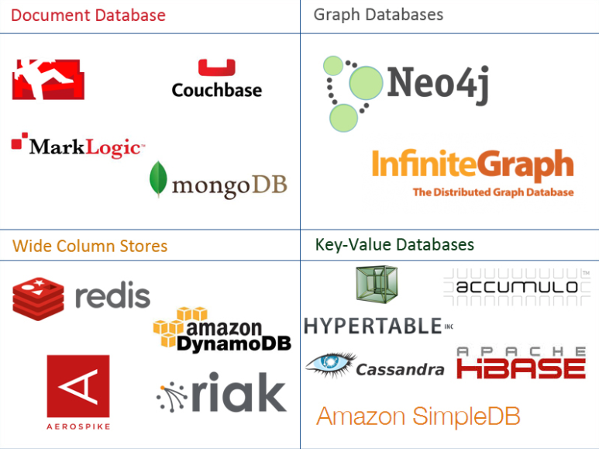
One Taxonomy

Slide 61
Graph DBs and Neo4j
61 | W4111-02024F-9-Module-II(3)-NoSql(3) © Donald F. Ferguson, 2024

Slide 62
Graph Database
Exactly what it sounds like
Two core types
Node
Edge (link)
Nodes and Edges have
Label(s) = “Kind”
Properties (free form)
Query is of the form
p1(n)-p2(e)-p3(m)
n, m are nodes; e is an edge
p1, p2, p3 are predicates on labels and properties
N->R->M

Slide 63
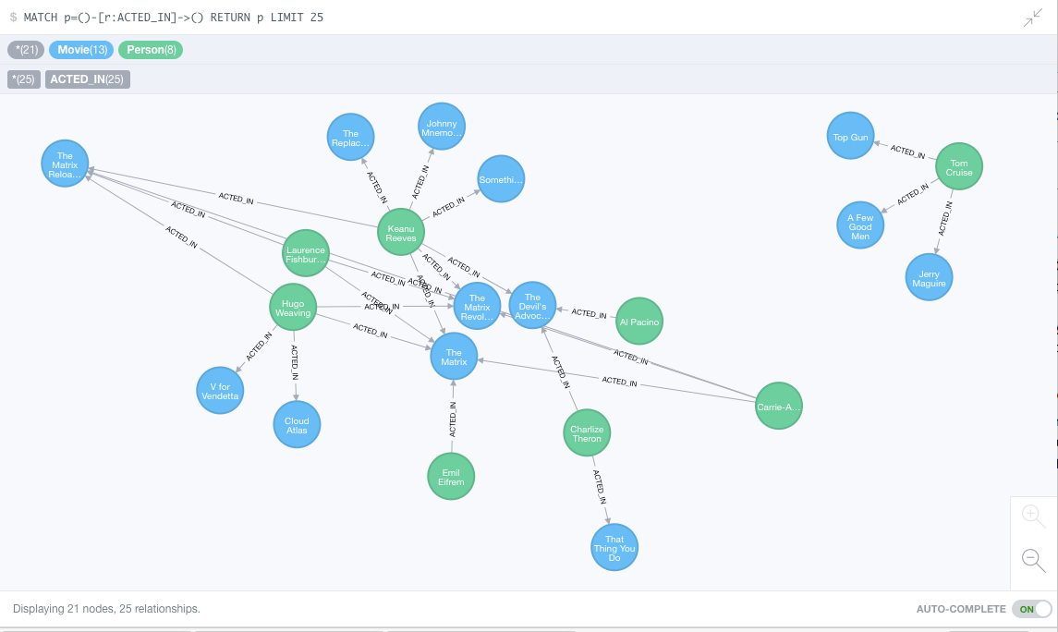
Neo4J Graph Query

Slide 64
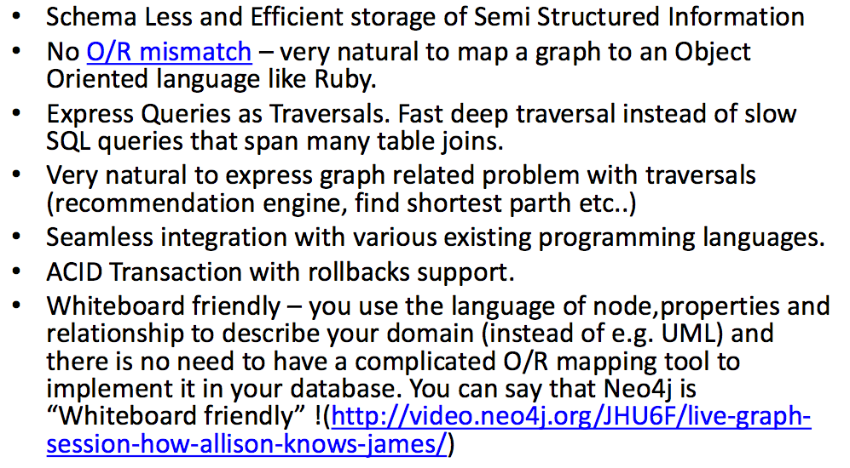
Why Graph Databases?

Slide 65
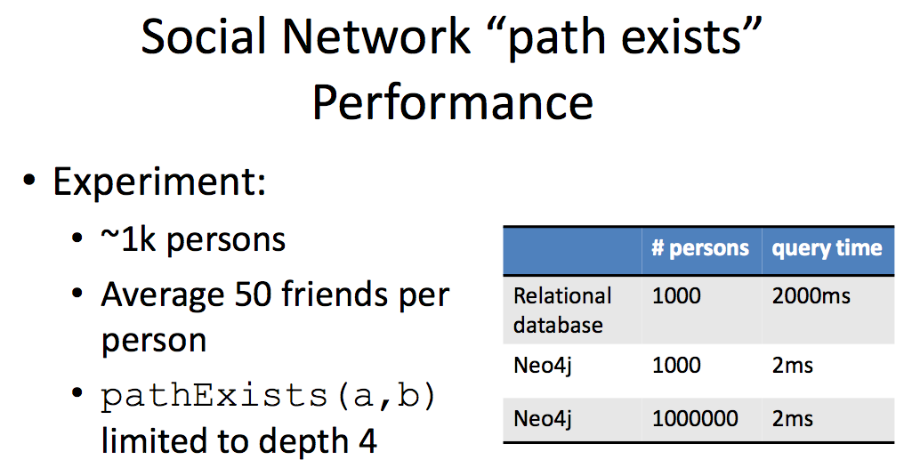
Graph Databases
Graph databases are
Extremely fast for some queries and data models.
Implement a language that vastly simplifies writing queries.

Slide 66
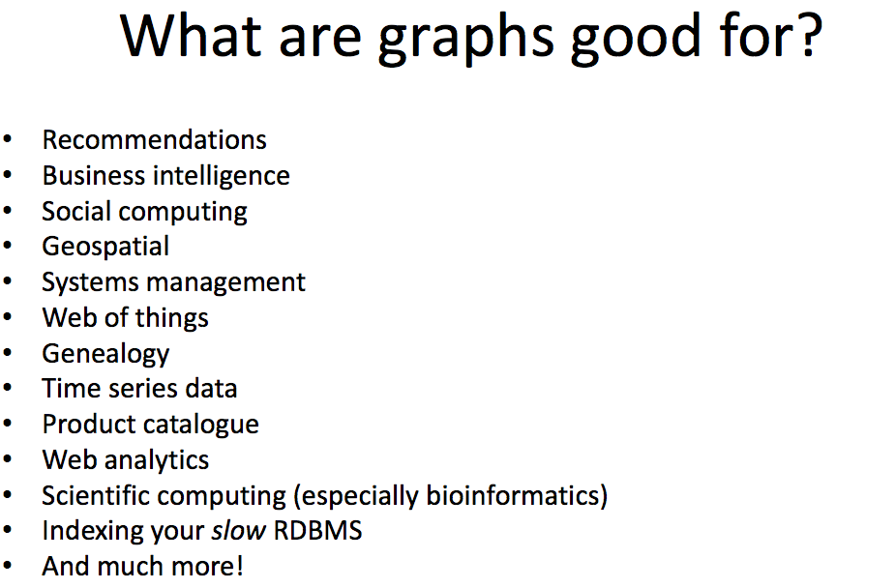

Slide 67
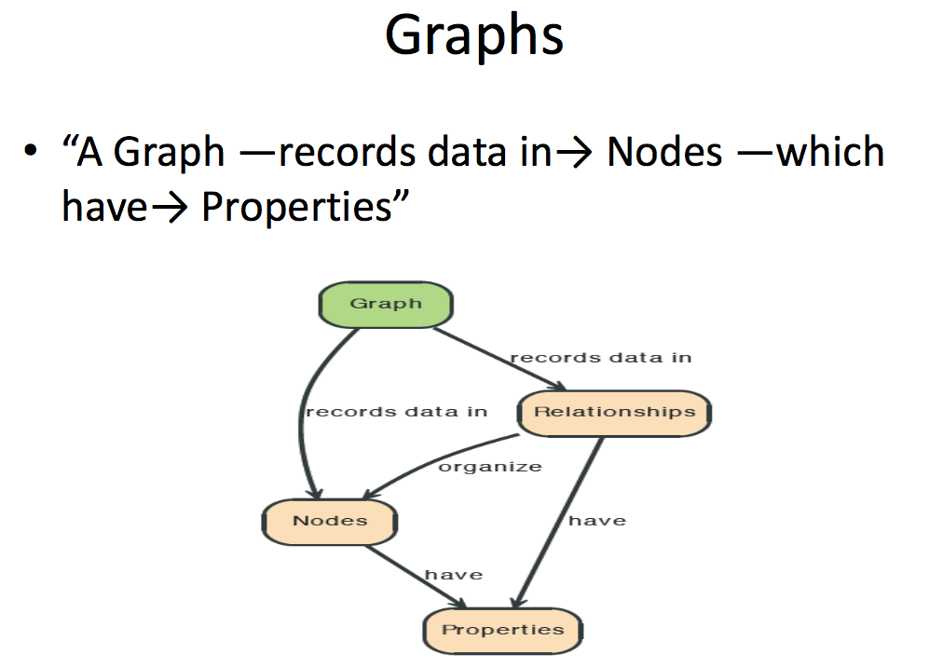

Slide 68
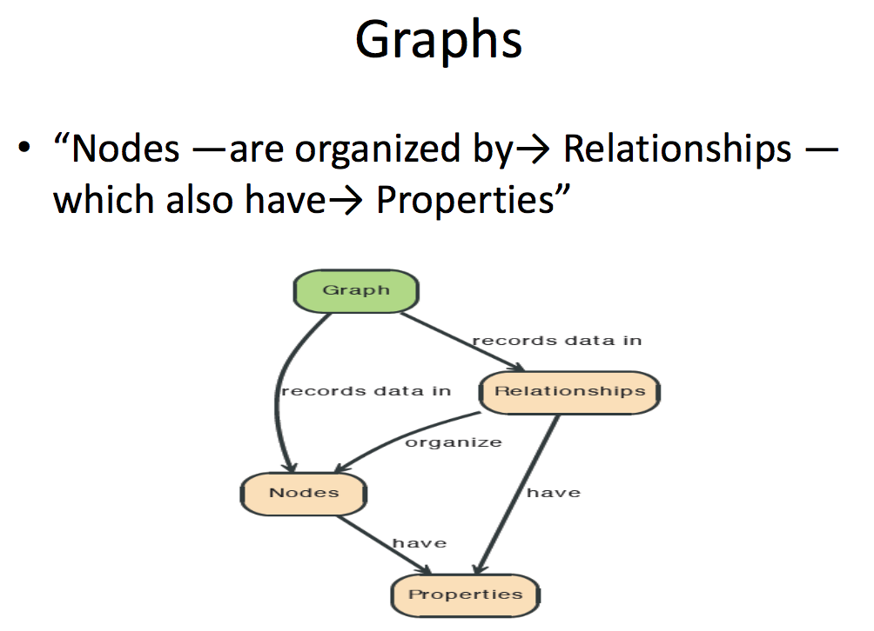

Slide 69
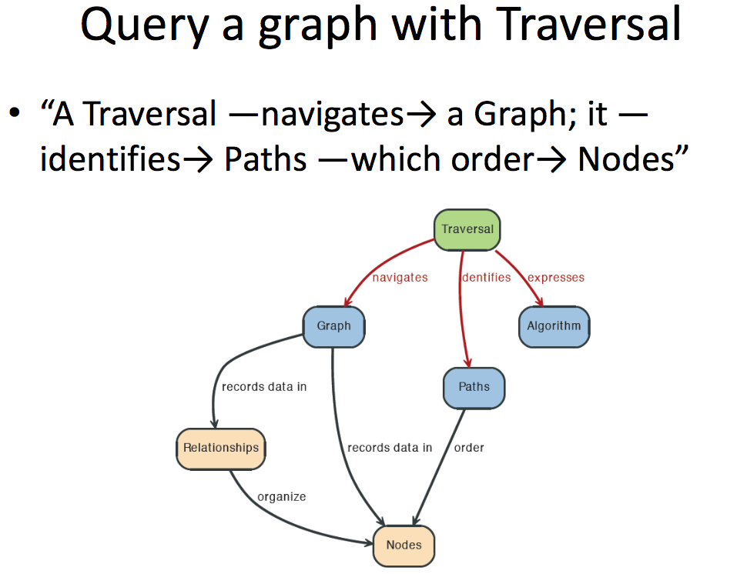

Slide 70
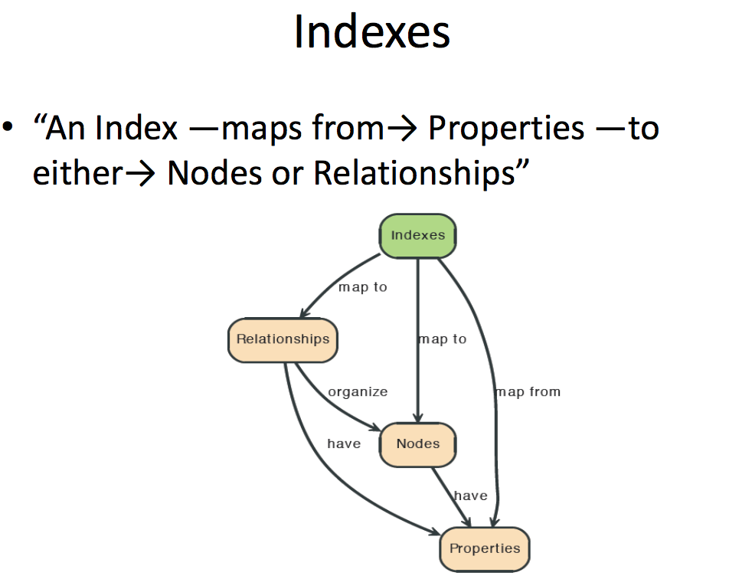

Slide 71
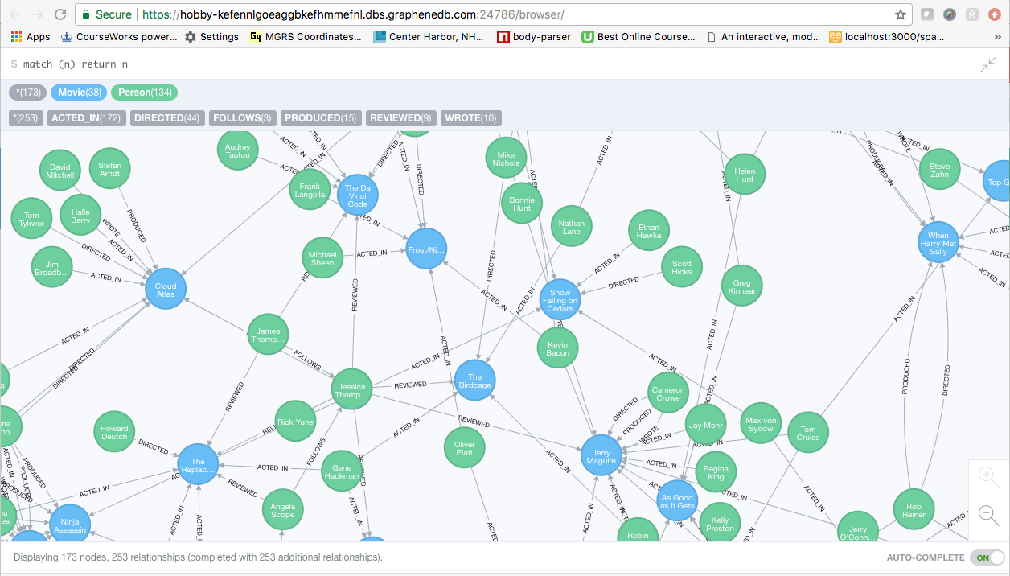
A Graph Database (Sample)

Slide 72
Neo4J Graph Query
Who acted in which movies?

Slide 73
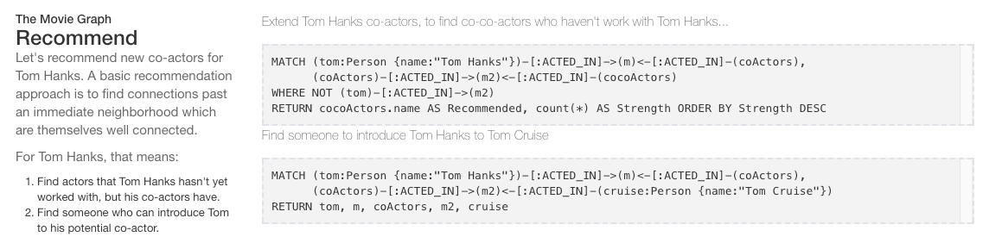
Big Deal. That is just a JOIN.
Yup. But that is simple.
Try writing the queries below in SQL.

Slide 74
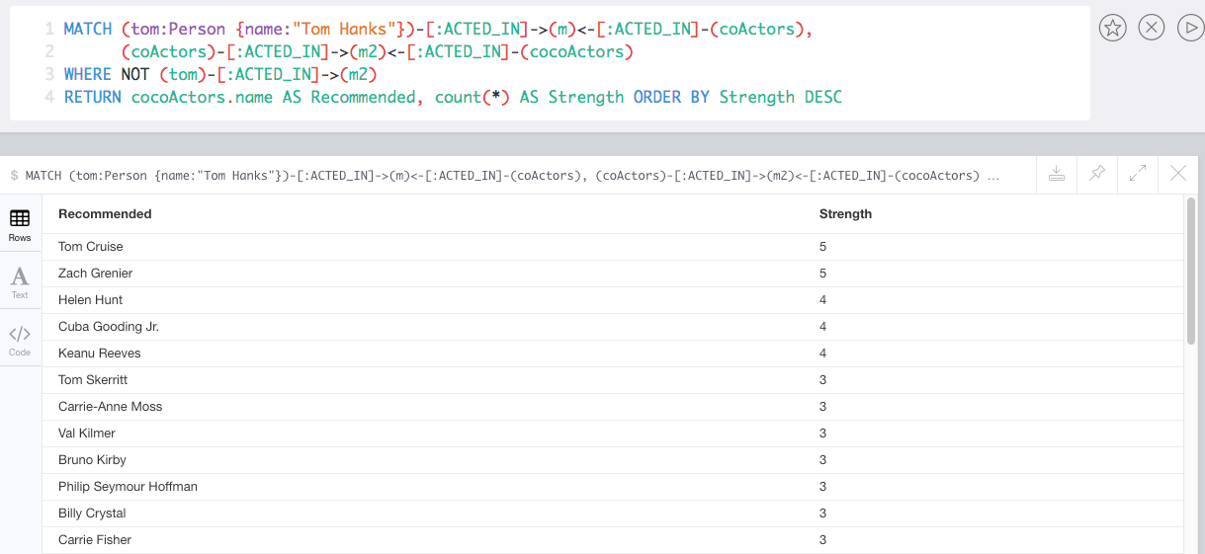
Recommend

Slide 75
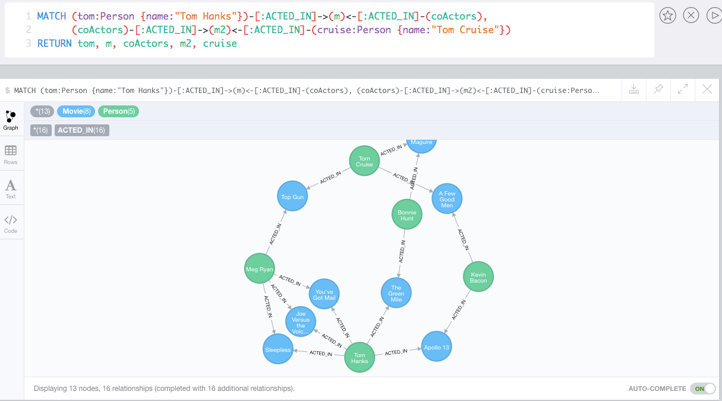
Which actors have worked with both Tom Hanks and
Tom Cruise?

Slide 76
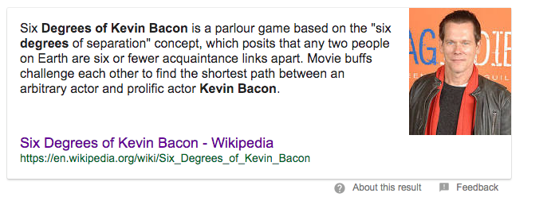
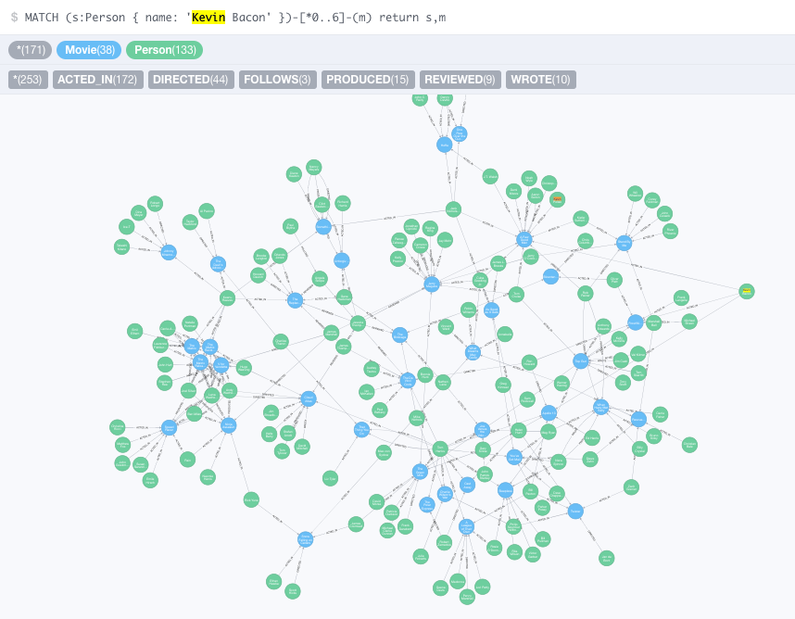


Slide 77
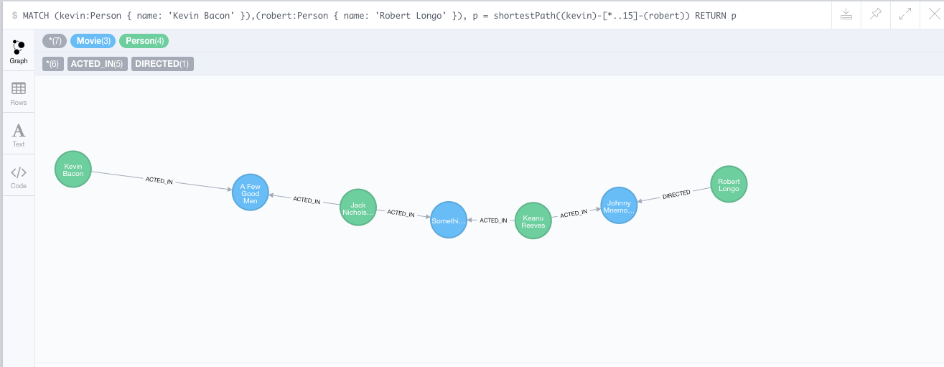
How do you get from Kevin Bacon to
Robert Longo?

Slide 78
Web Applications and REST
78 | W4111-02024F-9-Module-II(3)-NoSql(3) © Donald F. Ferguson, 2024

Slide 79
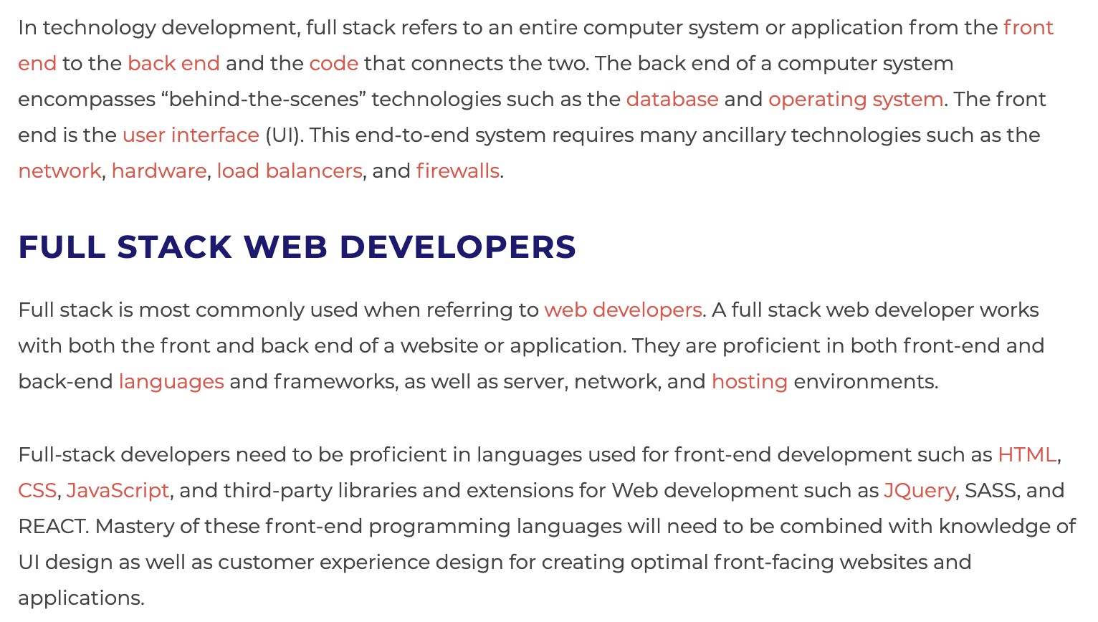
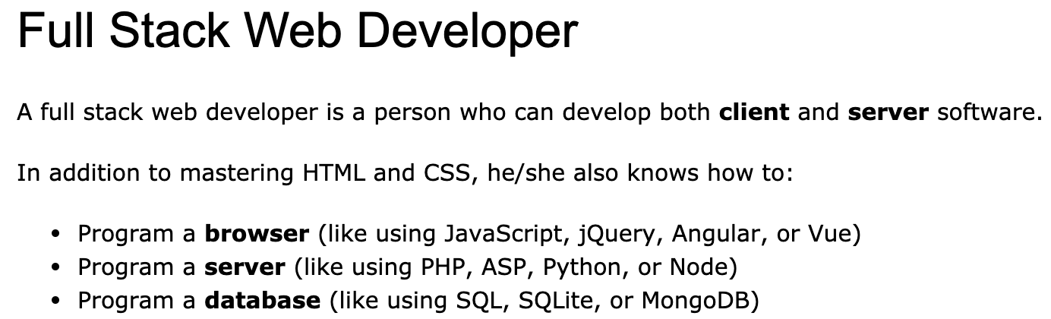
Full Stack Application
https://www.w3schools.com/whatis/whatis_fullstack.asp
There are courses that cover topics:
COMS W4153: Advanced Software Engineering
COMS W4111: Introduction to Databases
COMS W4170 - User Interface Design
This course will focus on cloud realization, microservices and application patterns, ... ...
Also, I am not great at UIs ... ... We will not emphasize or require a lot of UI work.
https://www.webopedia.com/definitions/full-stack/

Slide 80
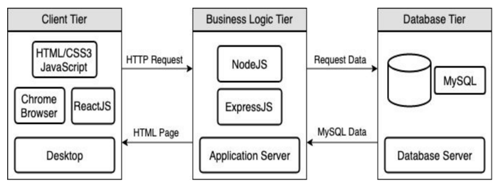
Full Stack Web Application
M = Mongo
E = Express
R = React
N = Node
I start with FastAPI and MySQL, but all the concepts are the same.
https://levelup.gitconnected.com/a-complete-guide-build-a-scalable-3-tier-architecture-with-mern-stack-es6-ca129d7df805
My preferences are to replace React with Angular, and Node with Flask.
There are three projects to design, develop, test, deploy, ... ...
Browser UI application.
Microservice.
Database.
We will initial have two deployments: local machine, virtual machine. We will ignore the database for step 1.

Slide 81
Some Terms
A web application server or web application framework: “A web framework (WF) or web application framework (WAF) is a software framework that is designed to support the development of web applications including web services, web resources, and web APIs. Web frameworks provide a standard way to build and deploy web applications on the World Wide Web. Web frameworks aim to automate the overhead associated with common activities performed in web development. For example, many web frameworks provide libraries for database access, templating frameworks, and session management, and they often promote code reuse.” (https://en.wikipedia.org/wiki/Web_framework)
REST: “REST (Representational State Transfer) is a software architectural style that was created to guide the design and development of the architecture for the World Wide Web. REST defines a set of constraints for how the architecture of a distributed, Internet-scale hypermedia system, such as the Web, should behave. The REST architectural style emphasises uniform interfaces, independent deployment of components, the scalability of interactions between them, and creating a layered architecture to promote caching to reduce user-perceived latency, enforce security, and encapsulate legacy systems.[1] REST has been employed throughout the software industry to create stateless, reliable web-based applications.” (https://en.wikipedia.org/wiki/REST)

Slide 82
Some Terms
OpenAPI: “The OpenAPI Specification, previously known as the Swagger Specification, is a specification for a machine-readable interface definition language for describing, producing, consuming and visualizing web services.” (https://en.wikipedia.org/wiki/OpenAPI_Specification)
Model: “A model represents an entity of our application domain with an associated type.” (https://medium.com/@nicola88/your-first-openapi-document-part-ii-data-model-52ee1d6503e0)
Routers: “What fastapi docs says about routers: If you are building an application or a web API, it’s rarely the case that you can put everything on a single file. FastAPI provides a convenience tool to structure your application while keeping all the flexibility.” (https://medium.com/@rushikeshnaik779/routers-in-fastapi-tutorial-2-adf3e505fdca)
Summary:
These are general concepts, and we will go into more detail in the semester.
FastAPI is a specific technology for Python.
There are many other frameworks applicable to Python, NodeJS/TypeScript, Go, C#, Java, … …
They all surface similar concepts with slightly different names.

Slide 83
REST (https://restfulapi.net/)
What is REST
REST is acronym for REpresentational State Transfer. It is architectural style for distributed hypermedia systems and was first presented by Roy Fielding in 2000 in his famous dissertation.
Like any other architectural style, REST also does have it’s own 6 guiding constraints which must be satisfied if an interface needs to be referred as RESTful. These principles are listed below.
Guiding Principles of REST
Client–server – By separating the user interface concerns from the data storage concerns, we improve the portability of the user interface across multiple platforms and improve scalability by simplifying the server components.
Stateless – Each request from client to server must contain all of the information necessary to understand the request, and cannot take advantage of any stored context on the server. Session state is therefore kept entirely on the client.
Cacheable – Cache constraints require that the data within a response to a request be implicitly or explicitly labeled as cacheable or non-cacheable. If a response is cacheable, then a client cache is given the right to reuse that response data for later, equivalent requests.
Uniform interface – By applying the software engineering principle of generality to the component interface, the overall system architecture is simplified and the visibility of interactions is improved. In order to obtain a uniform interface, multiple architectural constraints are needed to guide the behavior of components. REST is defined by four interface constraints: identification of resources; manipulation of resources through representations; self-descriptive messages; and, hypermedia as the engine of application state.
Layered system – The layered system style allows an architecture to be composed of hierarchical layers by constraining component behavior such that each component cannot “see” beyond the immediate layer with which they are interacting.
Code on demand (optional) – REST allows client functionality to be extended by downloading and executing code in the form of applets or scripts. This simplifies clients by reducing the number of features required to be pre-implemented.

Slide 84
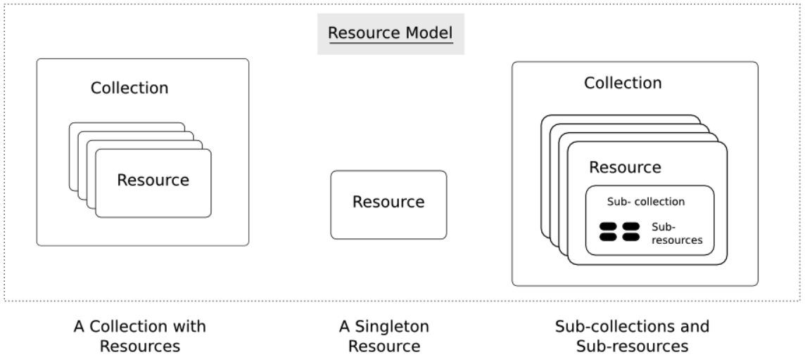
Resources
Resources are an abstraction. The application maps to create things and actions.
“A resource-oriented API is generally modeled as a resource hierarchy, where each node is either a simple resource or a collection resource. For convenience, they are often called a resource and a collection, respectively.
A collection contains a list of resources of the same type. For example, a user has a collection of contacts.
A resource has some state and zero or more sub-resources. Each sub-resource can be either a simple resource or a collection resource.
For example, Gmail API has a collection of users, each user has a collection of messages, a collection of threads, a collection of labels, a profile resource, and several setting resources.
While there is some conceptual alignment between storage systems and REST APIs, a service with a resource-oriented API is not necessarily a database, and has enormous flexibility in how it interprets resources and methods. For example, creating a calendar event (resource) may create additional events for attendees, send email invitations to attendees, reserve conference rooms, and update video conference schedules. (Emphasis added) (https://cloud.google.com/apis/design/resources#resources)
https://restful-api-design.readthedocs.io/en/latest/resources.html

Slide 85
REST – Resource Oriented
When writing applications, we are used to writing functions or methods:
openAccount(last_name, first_name, tax_payer_id)
account.deposit(deposit_amount)
account.close()
We can create and implement whatever functions we need.
REST only allows four methods:
POST: Create a resource
GET: Retrieve a resource
PUT: Update a resource
DELETE: Delete a resource
That’s it. That’s all you get.
A REST client needs no prior knowledge about how to interact with any particular application or server beyond a generic understanding of hypermedia.
“The key characteristic of a resource-oriented API is that it emphasizes resources (data model) over the methods performed on the resources (functionality). A typical resource-oriented API exposes a large number of resources with a small number of methods.” (https://cloud.google.com/apis/design/resources)

Slide 86
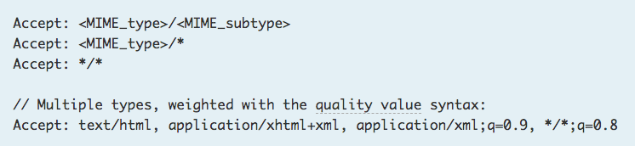
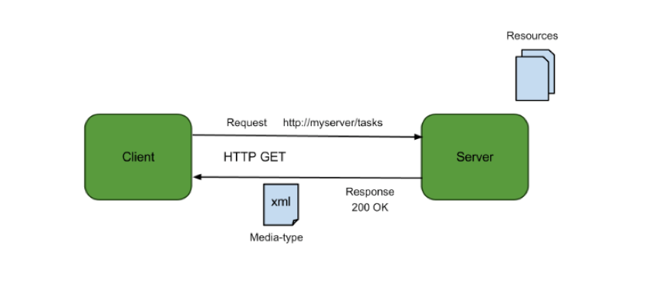
Resources, URLs, Content Types
Relative URL identifies “resource” on the server.
Server implementation maps abstract resource to tangible “thing,” file, DB row, … and any application logic.
Accept type in headers.
Client may be
Browser
Mobile device
Other REST Service
… …
Web media (content) type, e.g.
text/html
application/json

Slide 87
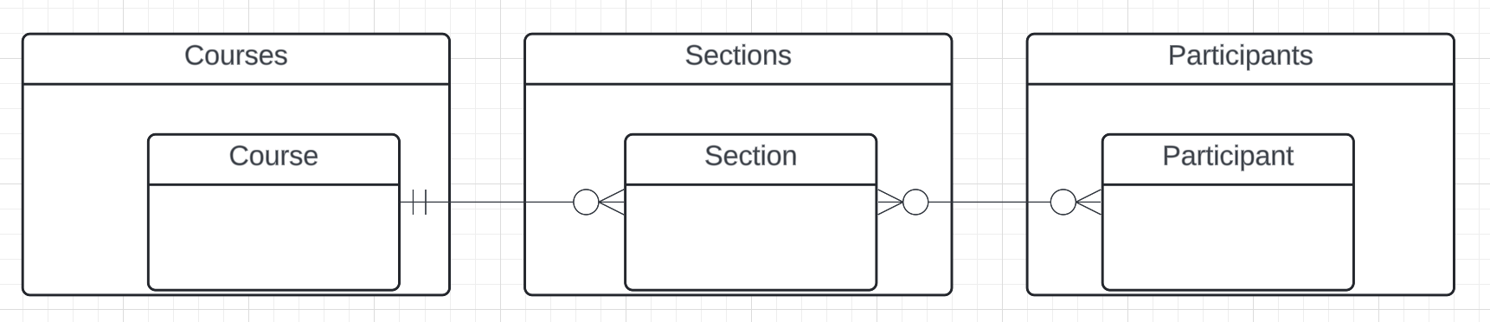
Resources and APIs
Base resources, paths and methods:
/courses: GET, POST
/courses/<id>: GET, PUT, DELETE
/sections: GET, POST
/sections/<id>: GET, PUT, DELETE
/participants: GET, POST
/participants/<id>: GET, PUT, DELETE
There are relative, navigation paths:
/courses/<id>/sections
/participants/<id>/sections
etc.
GET on resources that are collections may also have query parameters.
There are two approaches to defining API
Start with OpenAPI document and produce an implementation template.
Start with annotated code and generate API document.
In either approach, I start with models.
Also,
I lack the security permission to update CourseWorks.
I can choose to not surface the methods or raise and exception.

Slide 88
Data Modeling Concepts and REST
Almost any data model has the same core concepts:
Types and instances:
Entity Type: A definition of a type of thing with properties and relationships.
Entity Instance: A specific instantiation of the Entity Type
Entity Set Instance: An Entity Type that:
Has properties and relationships like any entity, but ...
Has at least one special relationship – contains.
Operations, minimally CRUD, that manipulate entity types and instances:
Create
Retrieve
Update
Delete
Reference/Identify/... ...
Host/database/table/pk

Slide 89
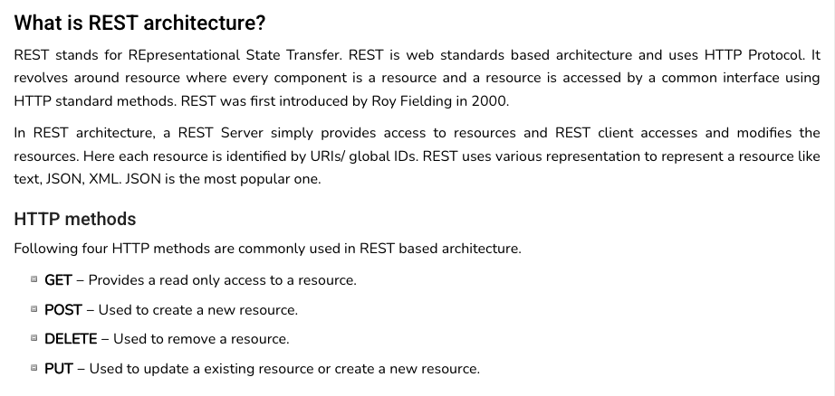
REST (https://www.tutorialspoint.com/restful/restful_introduction.htm)

Slide 90
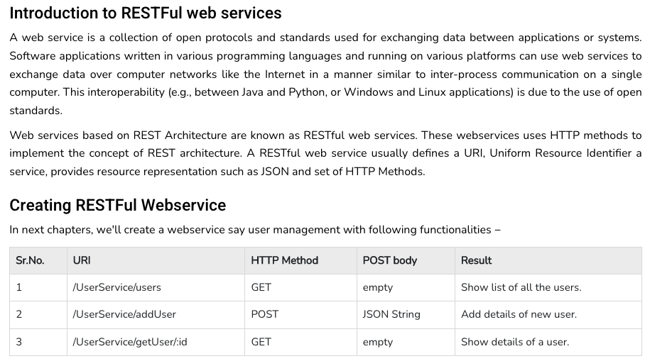
REST (https://www.tutorialspoint.com/restful/restful_introduction.htm)

Slide 91
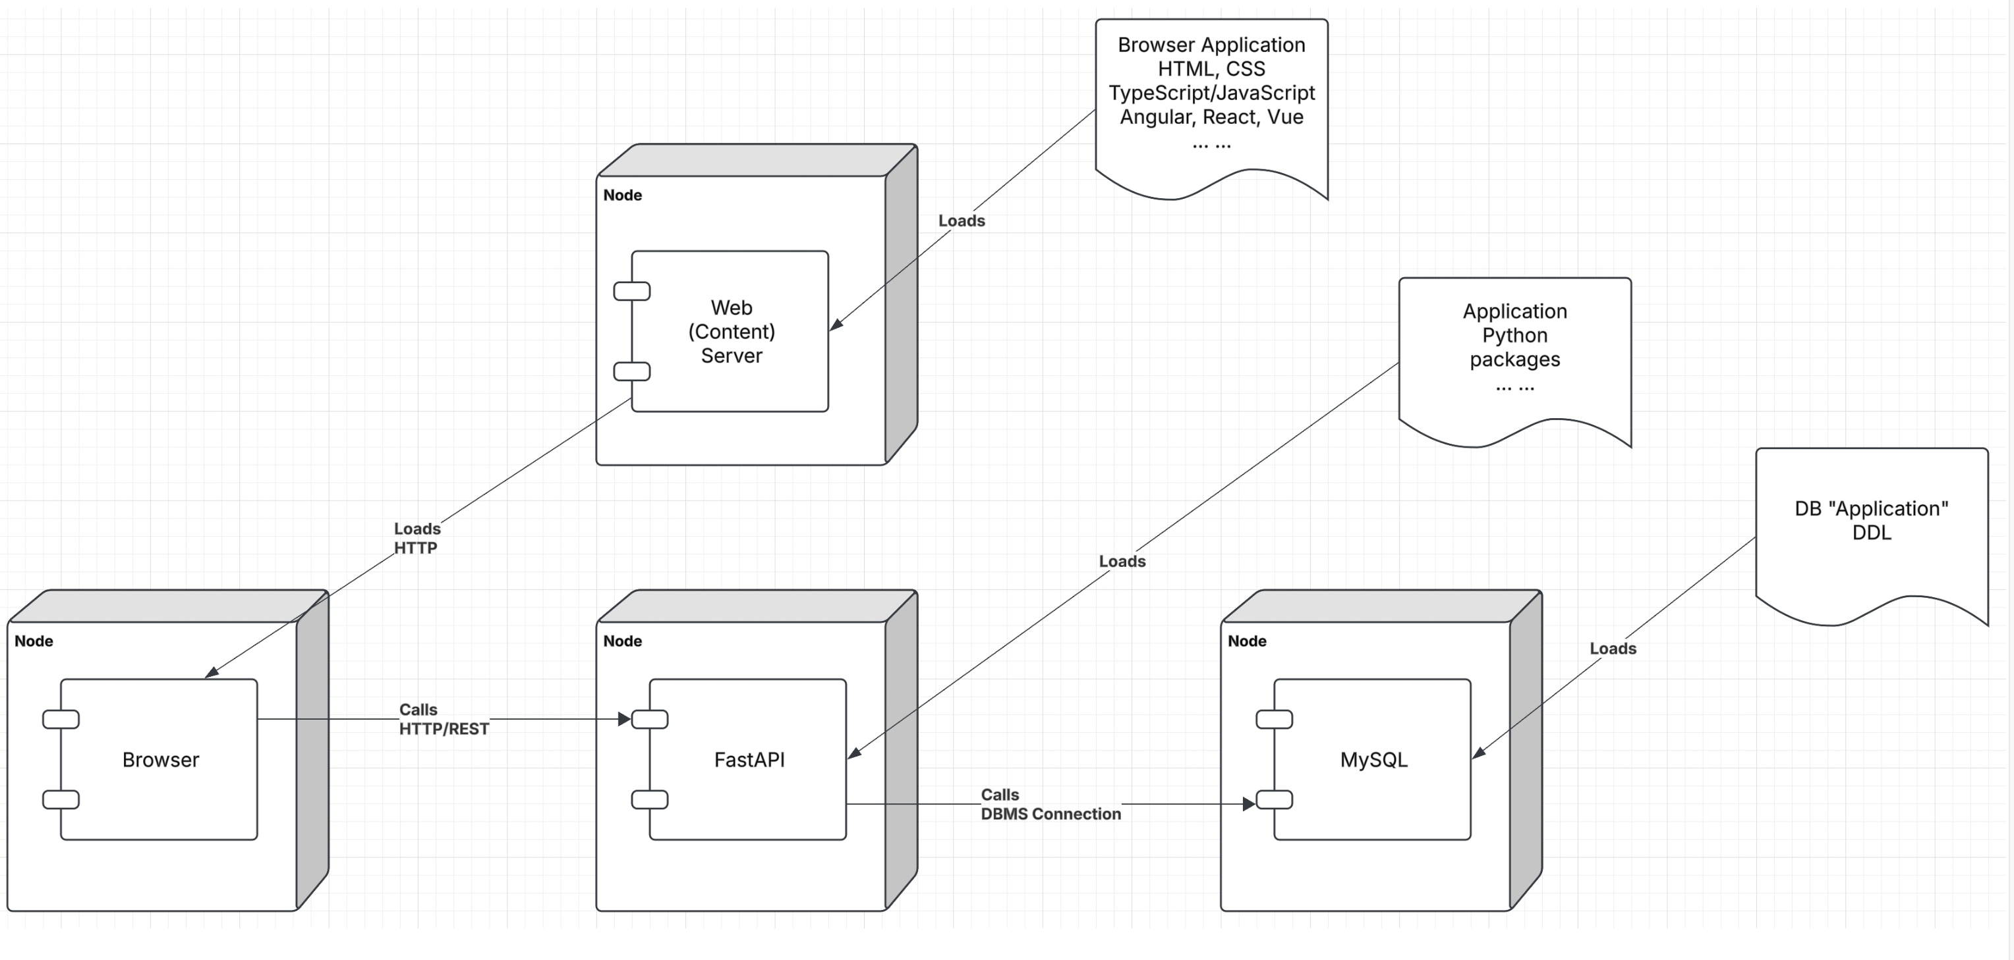
Let’s Look at the Programming Project

Slide 92
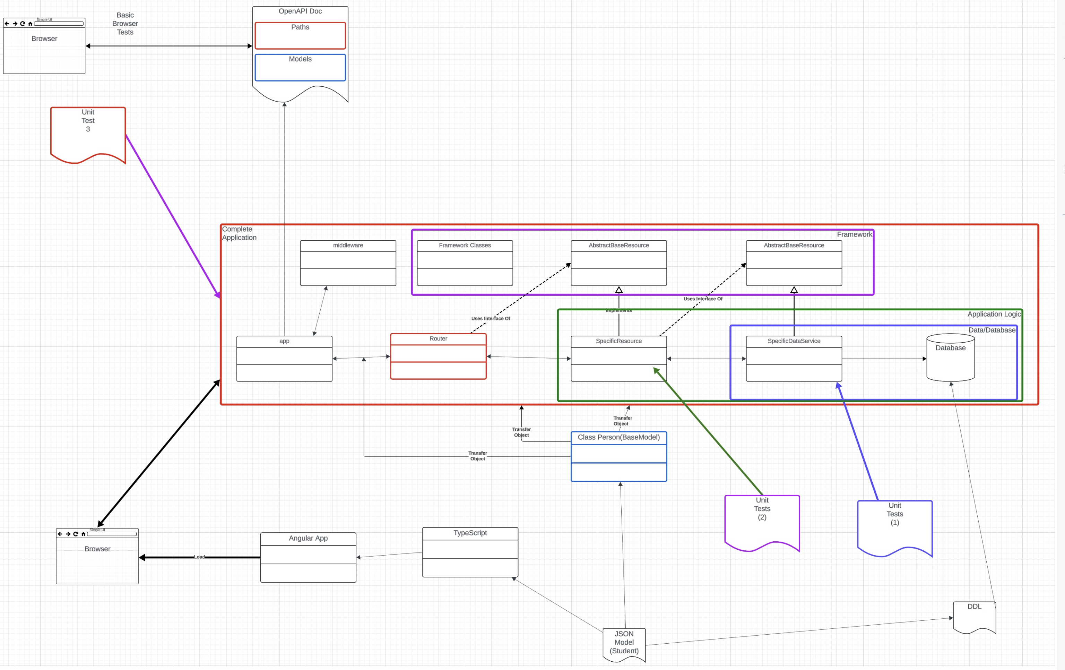
Let’s Look at the Programming Project

Slide 93
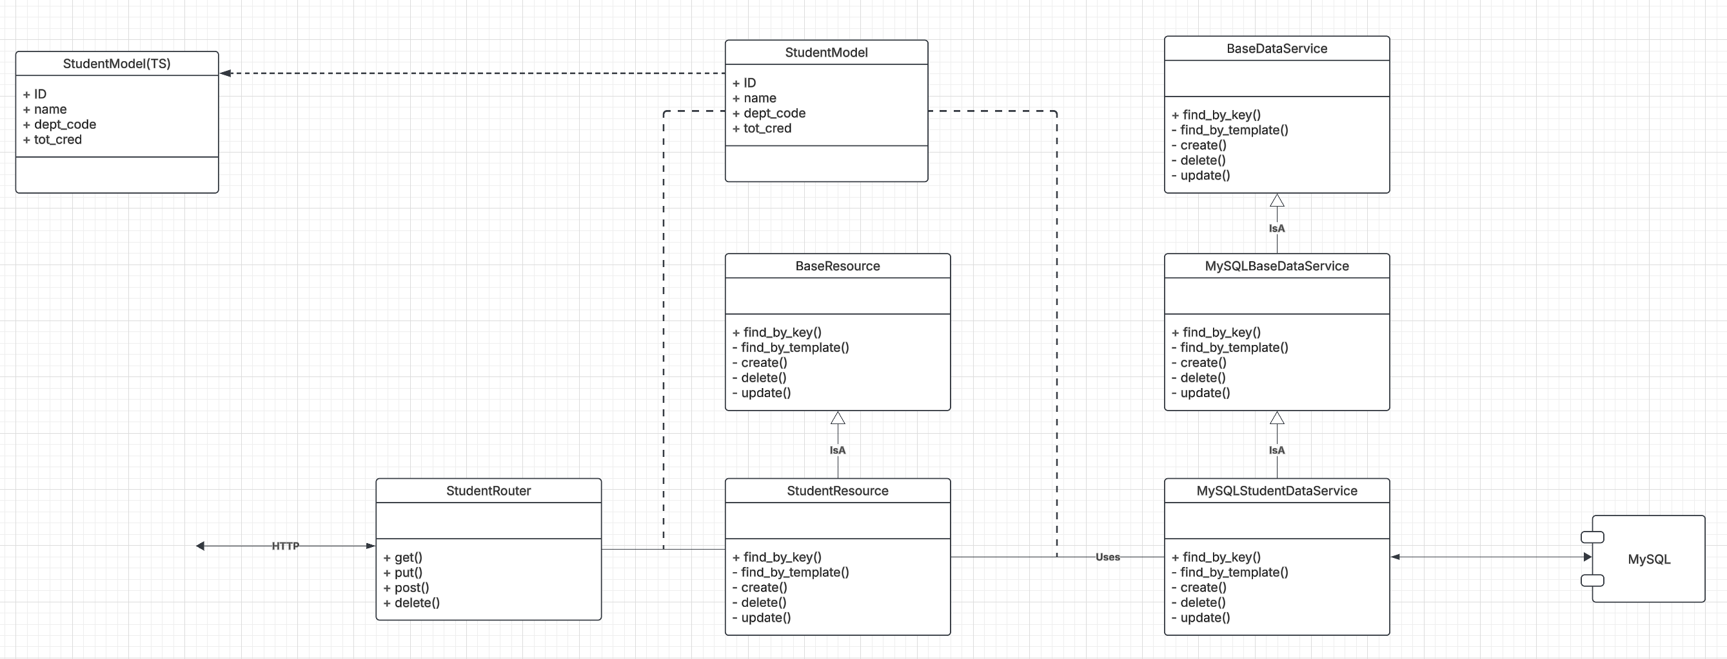
Let’s Look at the Programming Project

